Slide 1
Presentation
on
Artificial Intelligence based Defect and Code Changes Prediction for Reliable Software Delivery
Jalaj Pachouly
PRN: 19079001029
Research Supervisor: Dr. Swati Ahirrao
Department of Computer Science & Engineering
SYMBIOSIS INTERNATIONAL (DEEMED UNIVERSITY)

Slide 2
Outline
Introduction
Review of the Literature
Research Gaps
Problem Statement and Objectives
Methodology, Experimental results and Status of the objectives
Publications
Conclusion
Contributions
Future Scope
References
Q/A

Slide 3
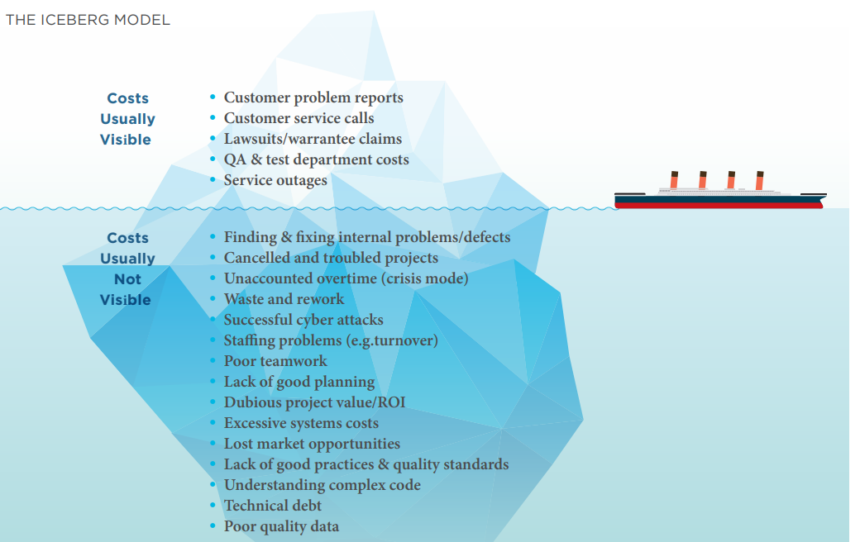
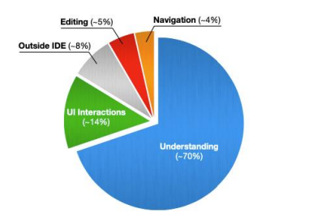
Introduction
CISQ Report - Total Cost of Software Failure in 2022: $2.41 Trillion
Total USA GDP in 2022 : 23.3 Trillion
Fact: Poor Software Quality Cost the U.S. Economy ~10.3% of its GDP in 2022
Fig. 1. Iceberg Model Showing Visible and Hidden Costs of Software Quality Issues.[19]

Slide 4
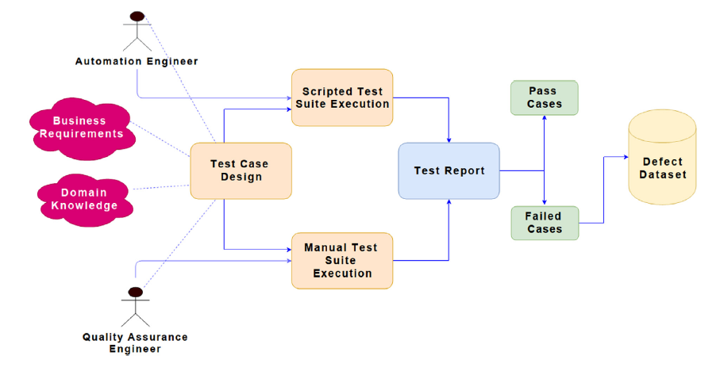
Introduction : How defects are logged
Fig. 2.. End-to-end workflow showing how test design, execution, and reporting generate pass/fail cases for defect dataset creation

Slide 5
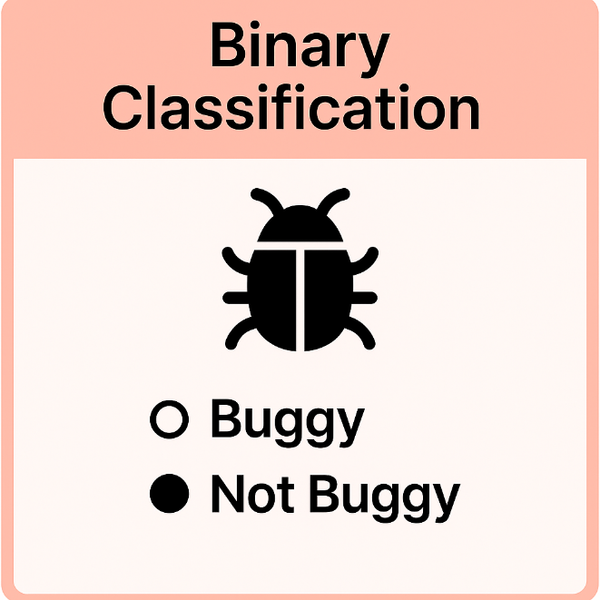
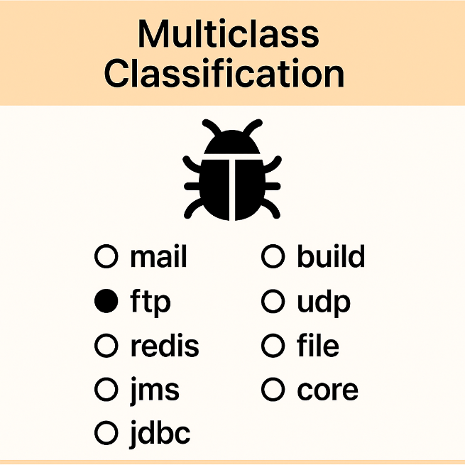
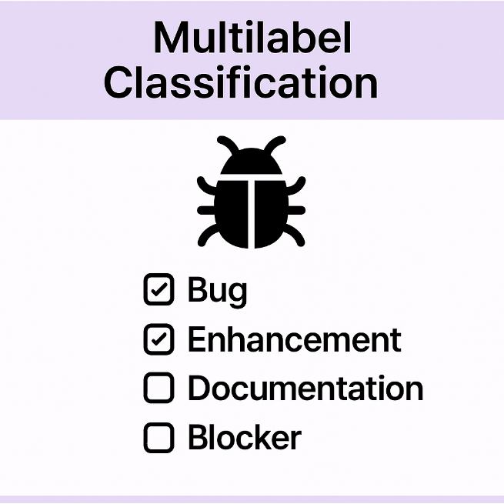
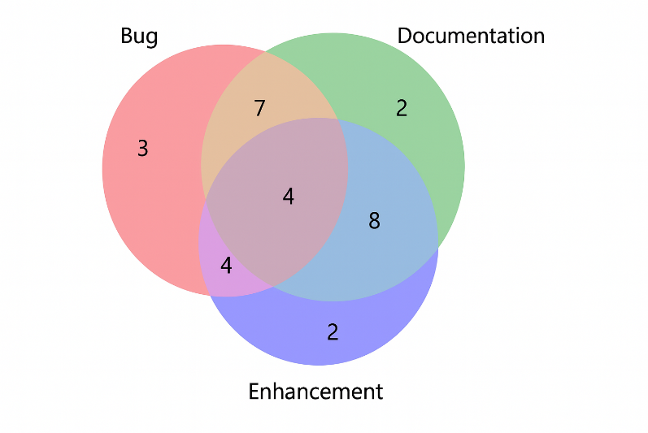

Introduction : Various nature of Software Defects
Fig. 3 Overlap of software issues

Slide 6
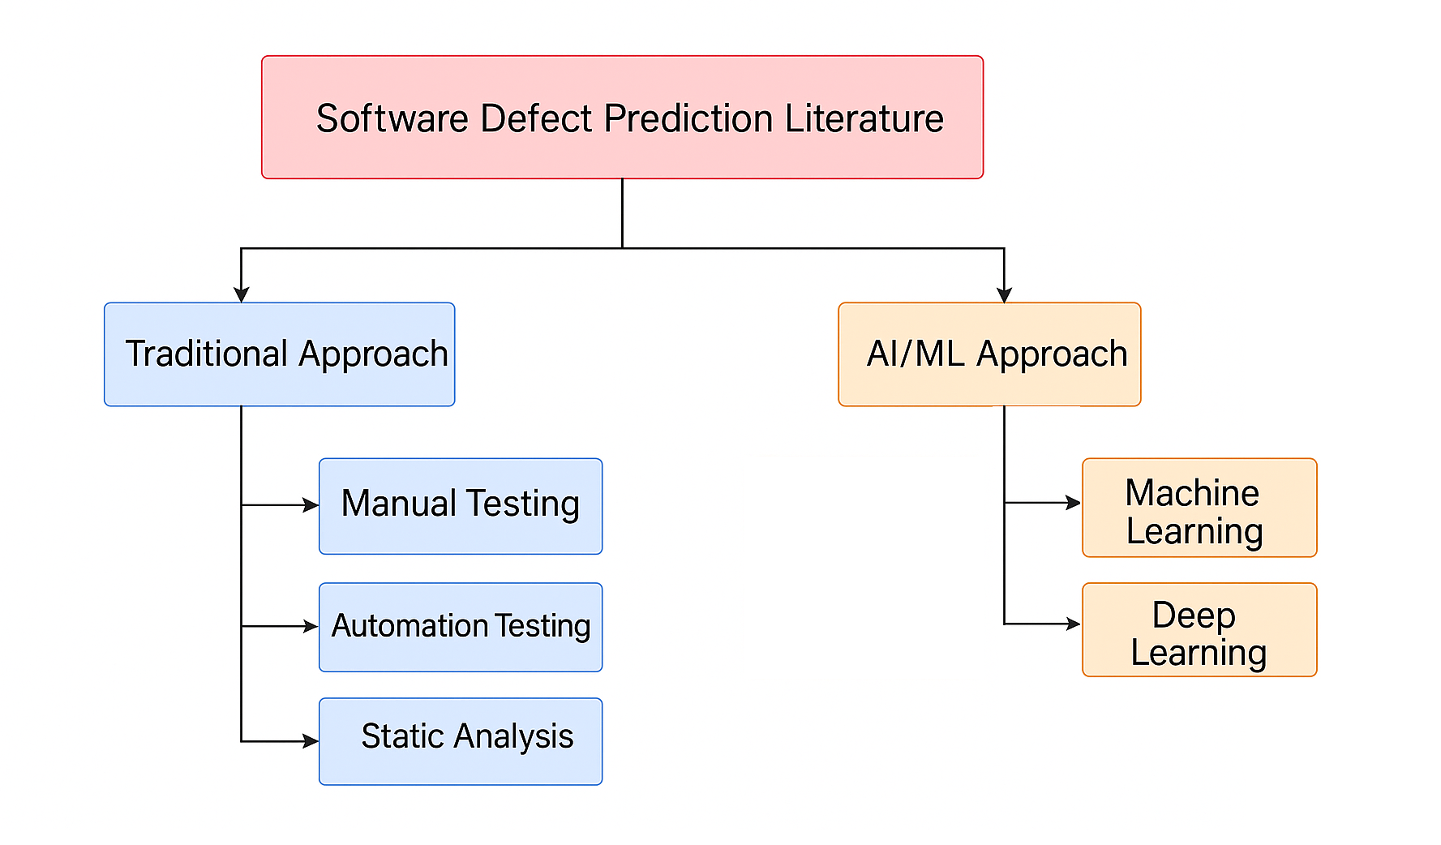
Literature Review
Fig. 4. Literature Taxonomy

Slide 7
Literature Review
Author | Title | Methodology | Dataset | Performance Metrics
Lessmann et al.[1] | Benchmarking Classification Models for Software Defect Prediction | Supervised ML (Bayesian, SVM, RF, C4.5); Unsupervised (clustering) | NASA (CM1, JM1), PROMISE | Accuracy: 70 %– 86 % F1-score: 0.65% – 0.80%
Khoshgoftaar & Allen [2] | Attribute Selection and Imbalanced Data: Problems in Defect Prediction | Supervised ML (Logistic Regression, Decision Trees) | NASA | Accuracy: 66% – 78 %
Catal & Diri [3] | Investigating Tuning of Classification Parameters for Defect Prediction | Supervised ML (Naïve Bayes, KNN, SVM, Logistic Regression) | PROMISE (JM1, KC1, PC1) | Accuracy: 73%– 81 %
Pascarella et al.[4] | Binary vs. Multiclass Defect Classification: An Empirical Study | Supervised ML (KNN, NB, MLP, SVM) | Apache & Bugzilla (JIRA) | F1-score: 0.71%
Jiang et al. [5] | An Empirical Comparison of Classifiers for Cross-Project Defect Prediction | Supervised ML (NB, KNN, SVM) | NASA, AEEEM | F1-score: 0.67% – 0.79%
Ghotra et al.[6] | Revisiting the Impact of Classification Techniques on Defect Prediction | Supervised ML (DT, SVM, NB, Neural Nets) | PROMISE | Accuracy: 70% – 85 %

Slide 8
Literature Review
Author | Title | Methodology | Dataset | Performance Metrics
Qiu et al. [7] | TCNN + DBN for Cross-Project Vulnerability Prediction | Transfer-CNN + Deep Belief Network | PROMISE | F1 (Log4j): 0.702%
Liang et al. [8] | LSTM-Based Defect Prediction with Improved Sampling | LSTM + ISDA (sampling-based augmentation) | PROMISE, GitHub | + 8.2 % F1 over DBN/ISDA
Fan et al. [9] | Attention-RNN for Apache Defect Prediction | Attention-based RNN | Apache projects | F1 ↑ 14 %; AUC ↑ 7 %
Gao & Wang [10] | MLP with SMOTE Sampling for Defect Prediction | Multilayer Perceptron + SMOTE | PROMISE, Eclipse | AUC up to 0.8501%
Dong et al. [11] | DNN-Based Android Defect Prediction | Deep Neural Network | GitHub (Android) | AUC = 0.8598%
Phan et al. [12] | CNN for Software Defect Prediction on Large Code Graphs | Convolutional Neural Network | GitHub | Outperforms standard ML on graph data (no single metric)

Slide 9
Literature Review
Author | Title | Methodology | Dataset | Performance Metrics
Lu et al. [13] | Survey of CI-Based Transfer Learning for Defect Prediction | Systematic Survey (transfer learning techniques) | Various public datasets | N/A (qualitative synthesis)
Hall et al.[14] | A Systematic Literature Review on Fault-Prediction Performance | Systematic Literature Review | ∼197 primary studies | N/A (SLR synthesis)
Hamalainen, Das & Mikkonen [15] | A Systematic Literature Review of Multilabel Learning in SE | Systematic Literature Review | 100 + studies on multilabel SE | N/A (SLR synthesis)
Ma et al. [16] | Transfer Component Analysis for Cross-Company Defect Prediction | Transfer Component Analysis (TCA for CPDP) | NASA | N/A (empirical gains reported)
Li et al. [17] | Automated Hyperparameter Tuning in Defect-Prediction Transfer Learning | Auto-tuned TCA | Public & private projects | N/A (CPDP improvements)
Xu et al. [18] | Unsupervised Pre-training with Autoencoders for Defect Prediction | Autoencoder + Fine-tuning | NASA, PROMISE | N/A (framework proposed)

Slide 10




Summary of the Literature Review
Binary focus
Most studies frame defect prediction as a simple buggy vs. non‑buggy task
Very little work on Multiclass or Multilabel assignments in diverse, real‑world repositories
Custom‑dataset shortfall
Nearly all studies use only a handful of public datasets
Tooling gaps - No widely adopted framework or GUI‑driven tool that
Centralizes dataset creation
Streamlines preprocessing
Bundles the entire workflow into one package
Multilabel Class imbalance & Sampling - Severe skew class balance not handled well
When tackled, researchers rely majorly on basic techniques:
Random oversampling
SMOTE

Slide 11





Research Gaps (Review Question)
Absence of Multiclass/Multilabel Prediction- Multiclass/Multilabel studies are missing in most of the studies.
Benchmark‐Only Datasets- Majority of the studies used a handful of public benchmarks (NASA, PROMISE), which don’t reflect the diversity of real‐world codebases or issue trackers.
Underexploited advanced and pre-trained Models- Few works adapt large pre-trained code or language models (e.g. BERT) to defect prediction.
No End-to-End Tooling- Despite many prototype scripts, there’s no GUI-driven or integrated framework that handles data retrieval, preprocessing, and ready to deploy dataset creation
Unassessed imbalance impact: The effect of severe class skew on multilabel and multiclass prediction metrics (e.g., per‐label recall) remains largely unexplored.

Slide 12
Problem Statement and Objectives
Problem Statement:
To develop an end-to-end AI system for Multilabel defect triage, including automated recommendation for software module where code changes required to resolve identified defect.
Objectives :
Development of defect dataset and performing data wrangling, data preprocessing.
To perform Multi-Label classification of defects using artificial intelligence techniques.
To predict the code changes required to fix the defects using artificial intelligence techniques.
To develop a tool with artificial intelligence techniques, to generate the futuristic recommendations.

Slide 13
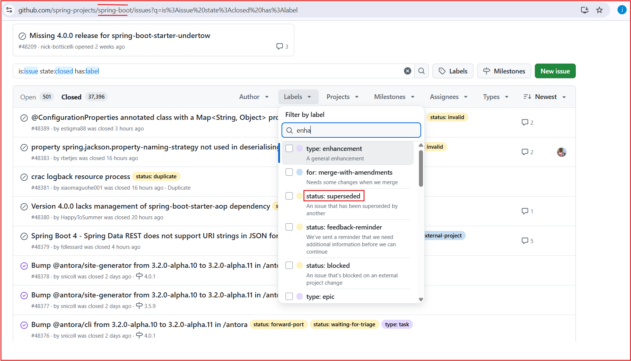
Objective 1 : Developing a dataset
Fig. 5. Example of Multilabel defect records from GitHub issues, showcasing simultaneous assignment of bug, blocker, and regression labels.

Slide 14
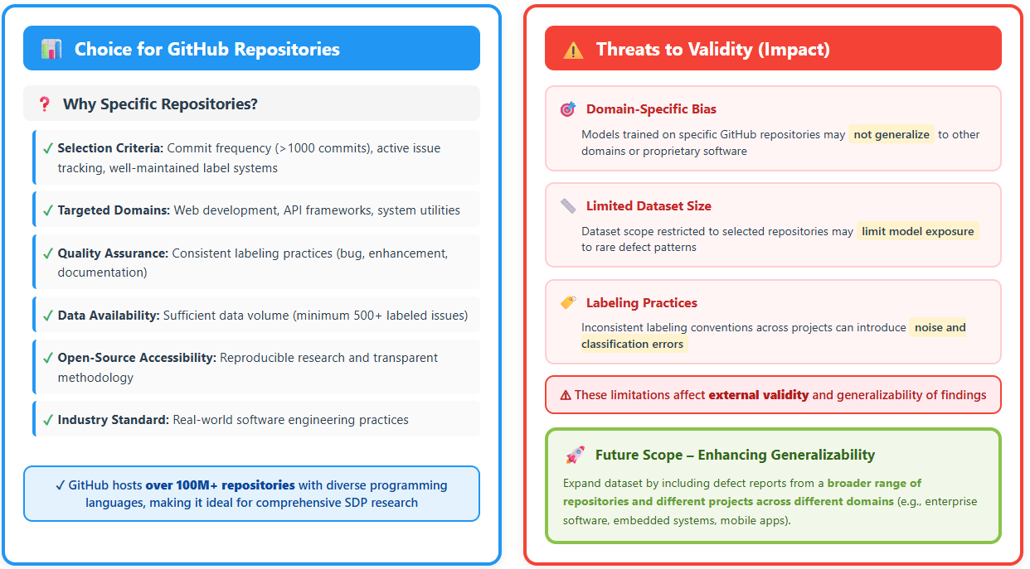
Objective 1 : Dataset Selection & Threats to Validity ( Review Question)
Fig. 6. Example of Multilabel defect records from GitHub issues, showcasing simultaneous assignment of bug, blocker, and regression labels.

Slide 15
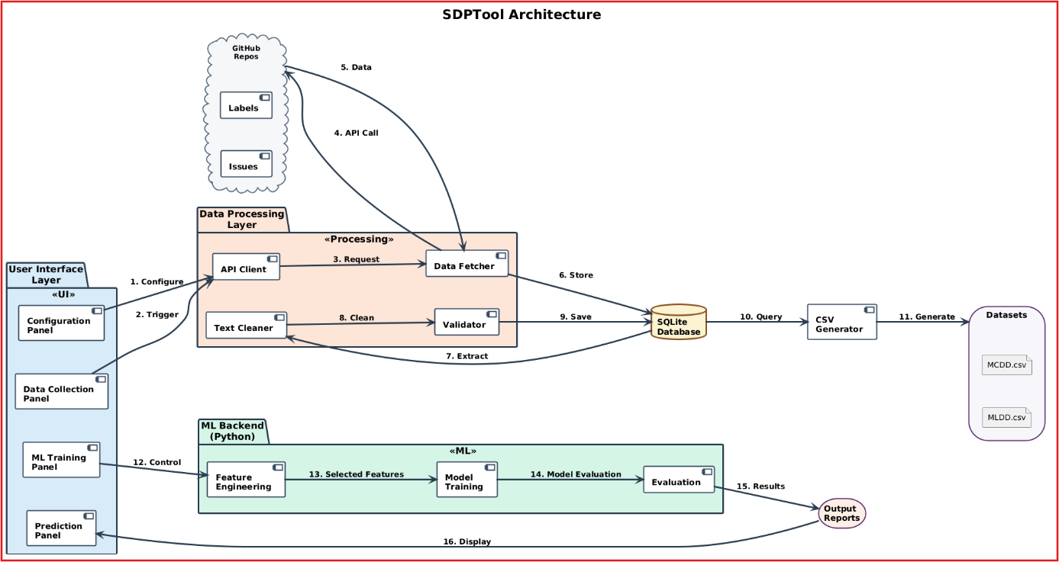
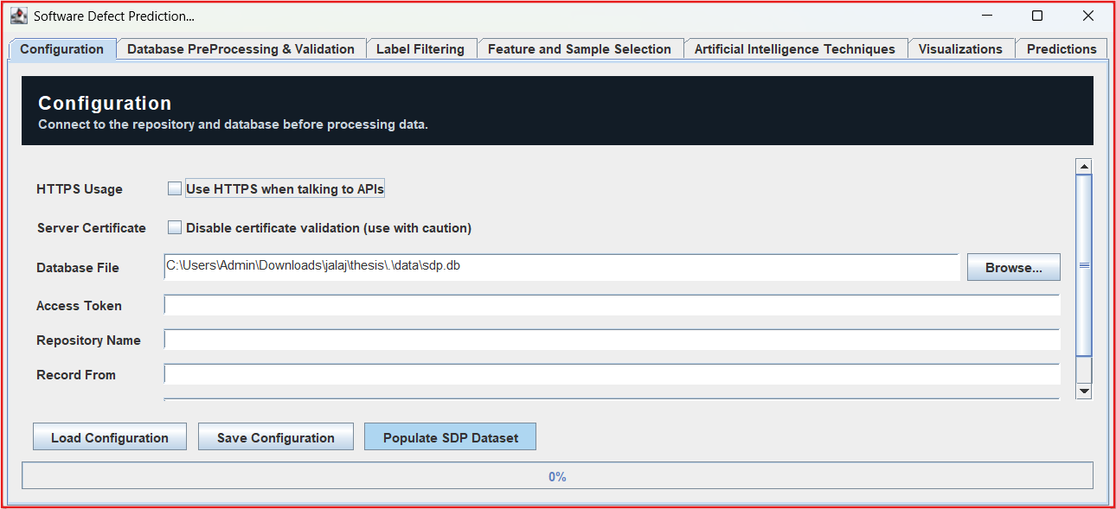
High-Level Architecture and Workflow
Fig. 7. Proposed methodology

Slide 16
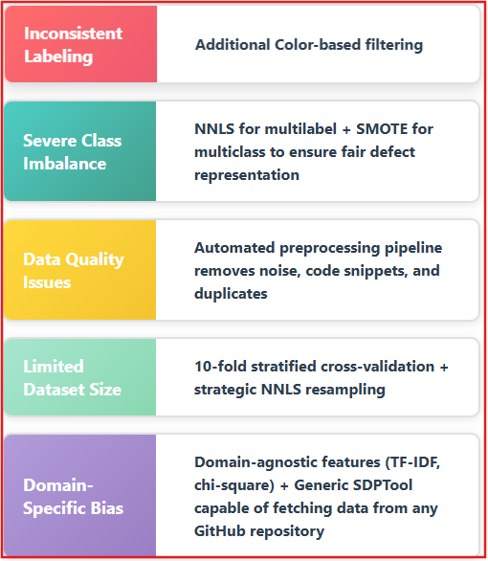
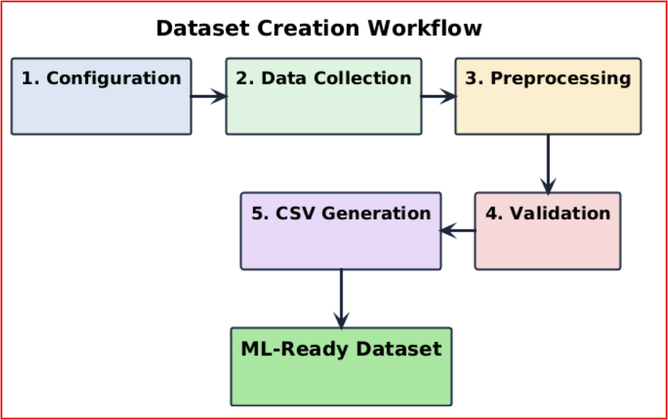
Objective 1 : Developing a Dataset and Threats to Validity & Mitigation (Review Question)
Dataset Name | GitHub Repository Link
Multilabel Defect Dataset (MLDD) | https://github.com/jalajpachouly/multilable-prediction/blob/main/dataset.csv
Multiclass Defect Dataset (MCDD) | https://github.com/jalajpachouly/software-change-type-prediction/blob/main/dataset.csv
Fig. 8. Dataset creation process -workflow

Slide 17
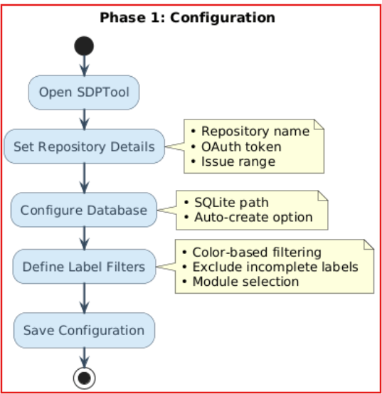
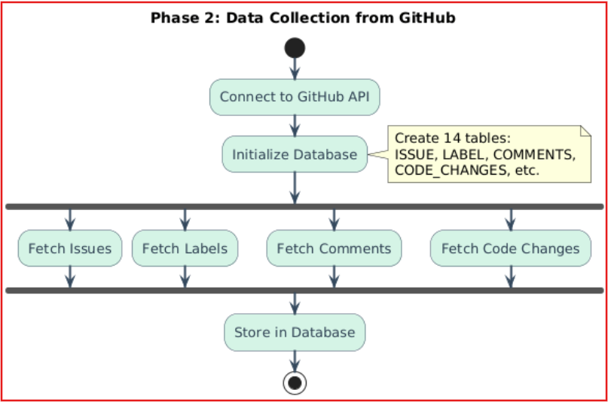
Objective 1 : Developing a Dataset Cont..
Fig. 9. Dataset creation process- Tool Configuration and Data Collection

Slide 18
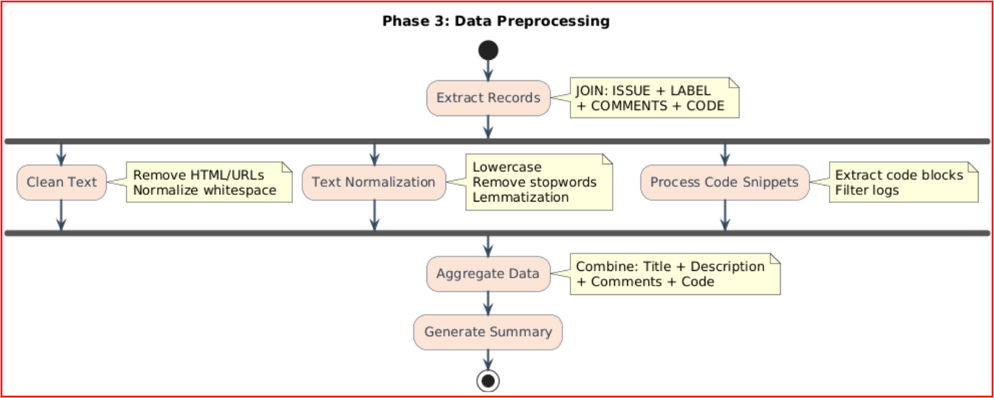
Objective 1 : Developing a dataset
Fig. 10. Dataset creation process –data pre-processing

Slide 19
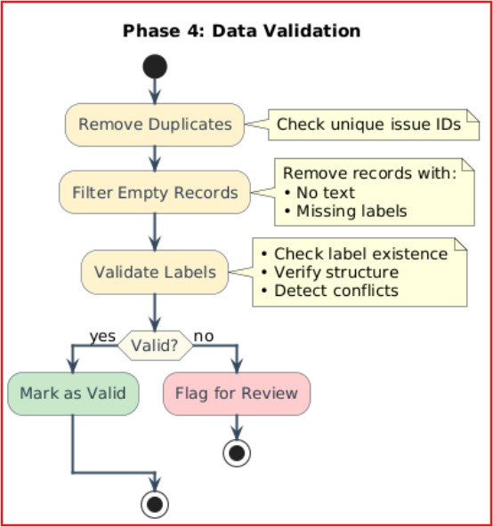
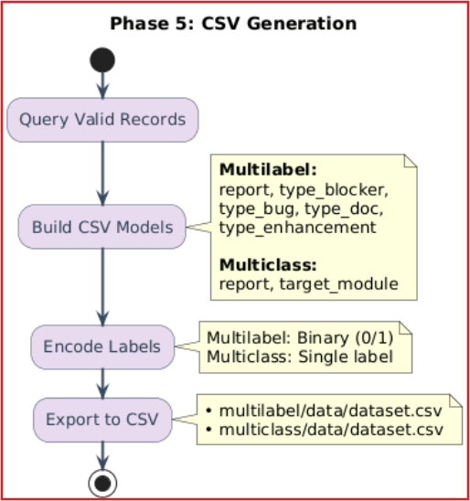
Objective 1 : Developing a dataset
Fig. 11. Dataset creation process –validation and export

Slide 20
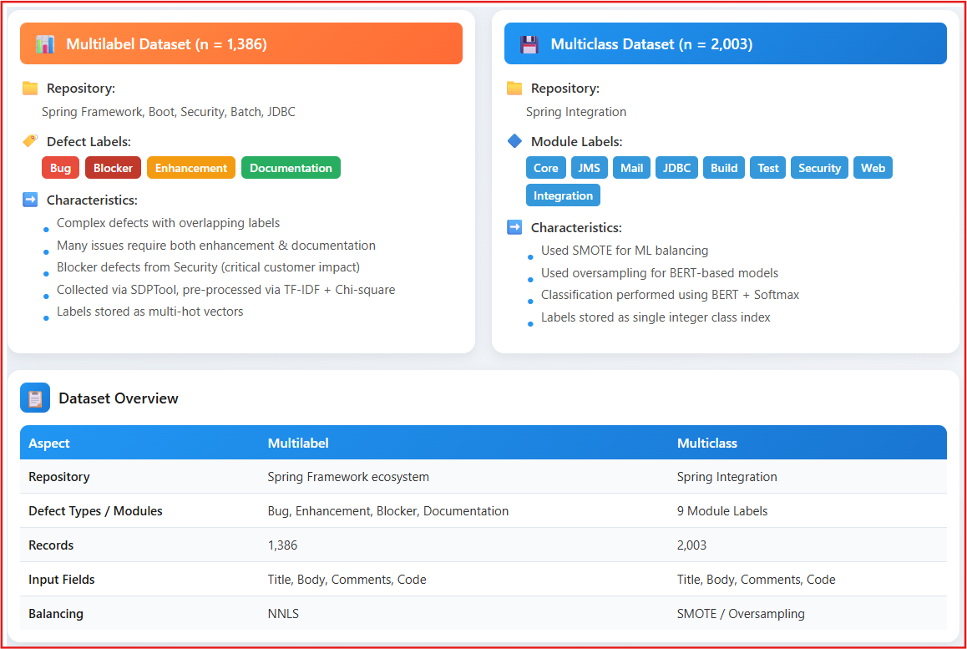
Objective 1 : Developing a dataset
Tab. 1. Dataset construction - overview for Multilabel and Multiclass defect

Slide 21
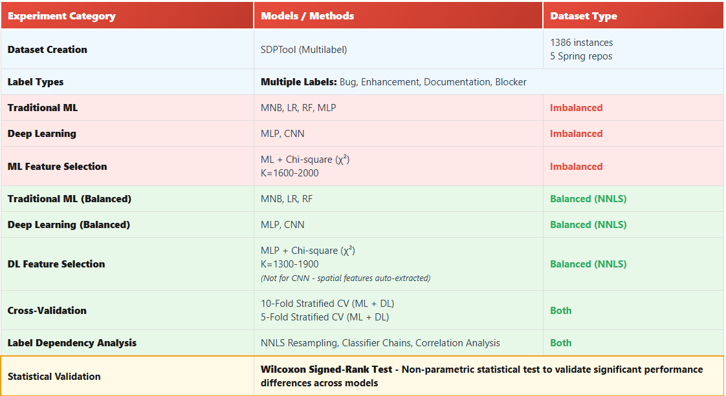
Objective 2 : Experiments- Multilabel classification
Tab. 2. Experiments conducted for Multilabel Classification

Slide 22
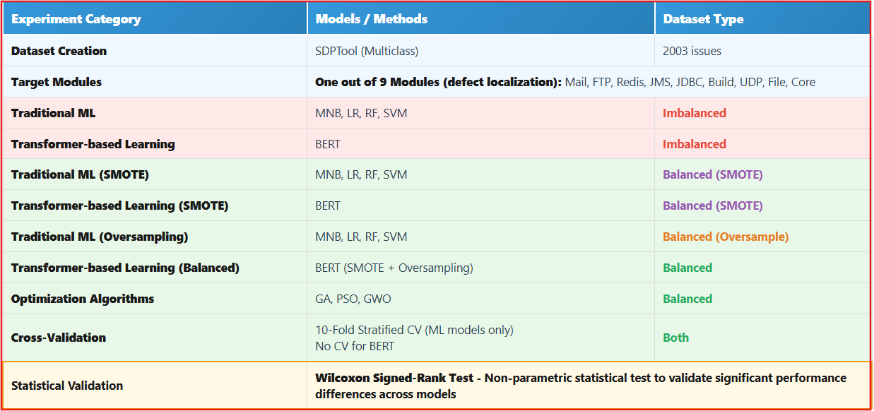
Objective 3 : Experiments- Multiclass classification
Tab. 3. Experiments conducted for Multiclass Classification

Slide 23
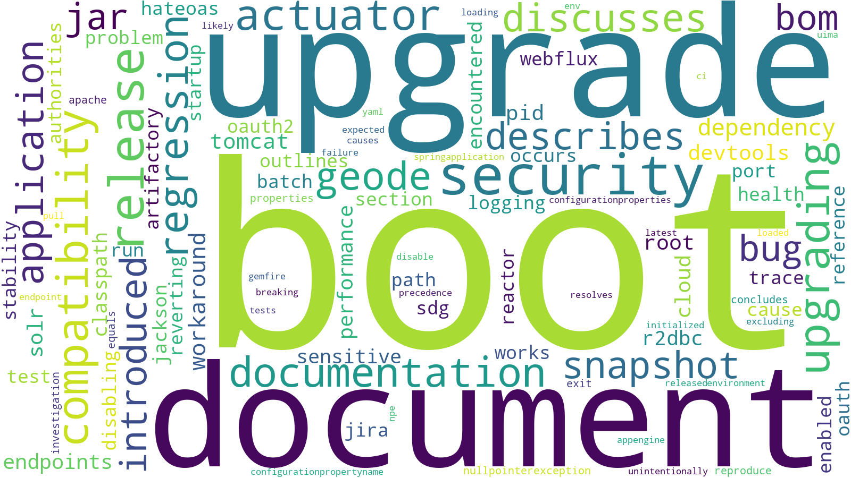
Objective 2 : Feature Selection using χ²
Fig. 12. Word cloud visualization for top 200 features selected using χ² feature selection for label type Document

Slide 24
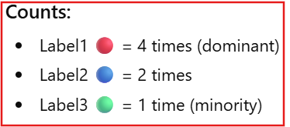
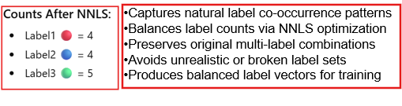
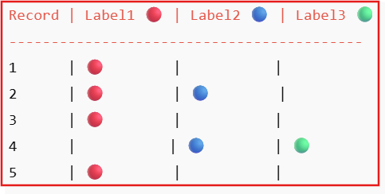
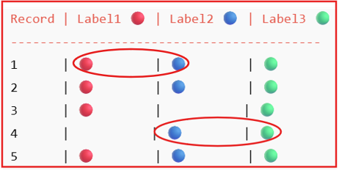
Objective -2 : NNLS- Handle Class Imbalance (Review Question)
Example - Target label count = 4
Fig. 13. How NNLS helps in class balancing

Slide 25
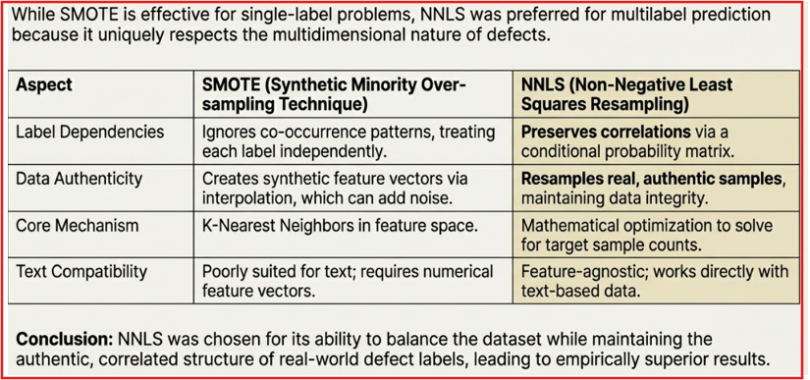
Objective -2 : SMOTE vs NNLS for Handling Class Imbalance (Review Question)
Tab. 4. SMOTE vs NNLS Class Balancing

Slide 26
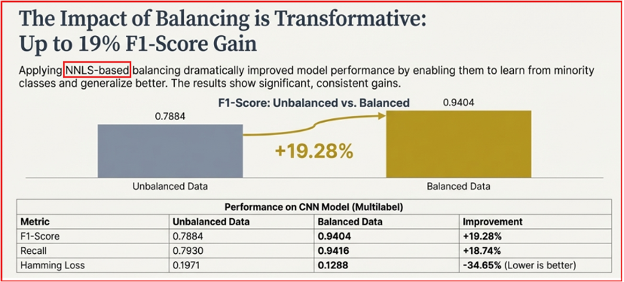
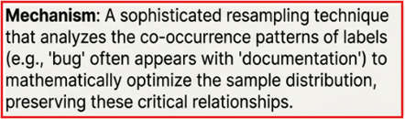
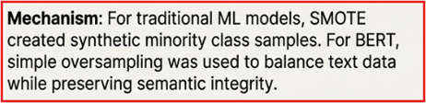
Objective -2,3 : Handling Class Imbalance (Review Question)
NNLS
SMOTE
Fig. 14. Impact of NNLS class balancing in model performance

Slide 27
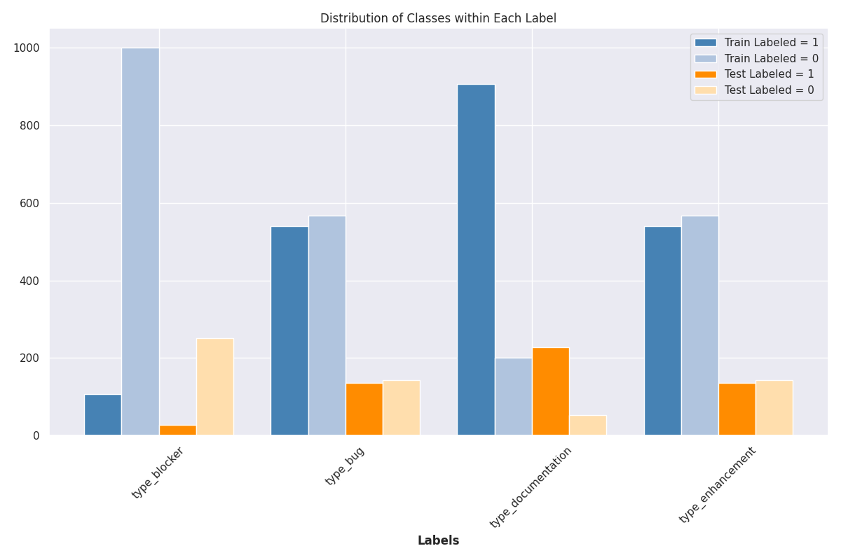
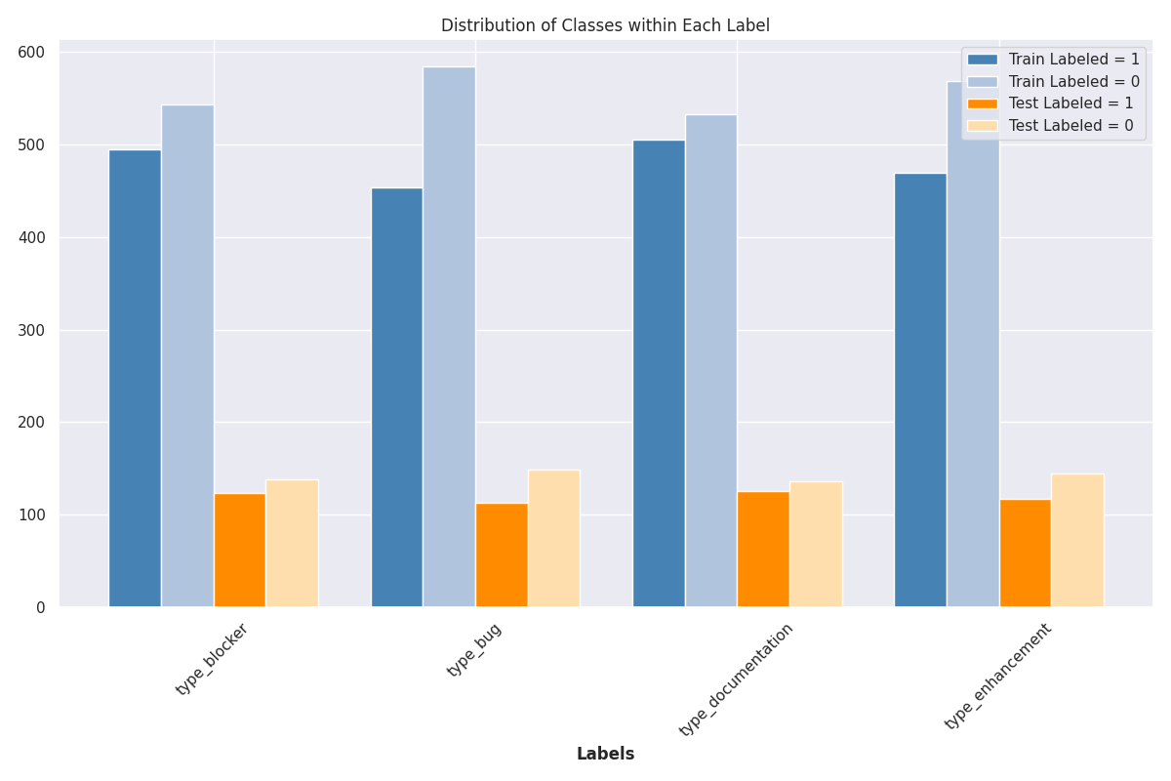
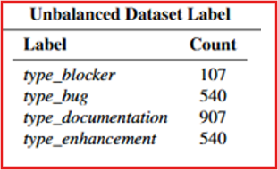
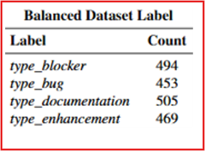
Objective 2 :Balanced vs Imbalanced class counts
Before balancing:
Imbalance ratio ≈ 8.5
(High Class Imbalance)
After balancing:
Imbalance ratio ≈ 1.1
(Almost uniform)
Fig. 15. Label-wise distribution of train-test samples in unbalanced (left) and NNLS -balanced (right) Multilabel datasets, along with class counts per label.

Slide 28
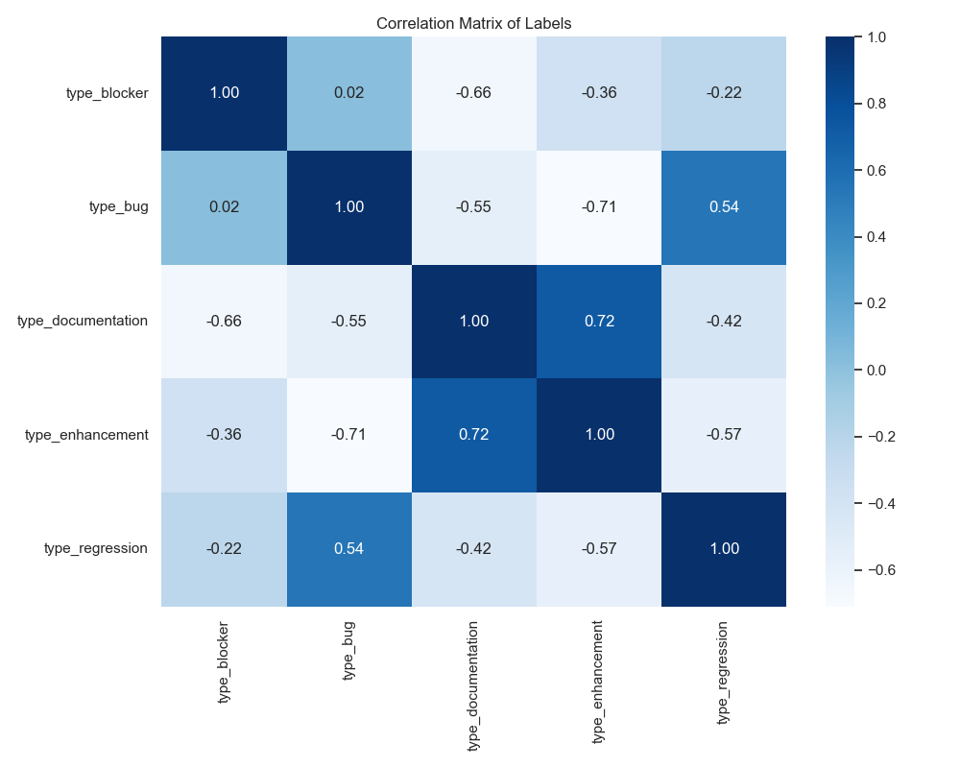
Objective 2 : Correlation across Multiple lables
Fig. 16. Correlation matrix depicting co-occurrence relationships among Multilabel defect categories in the dataset [20].

Slide 29
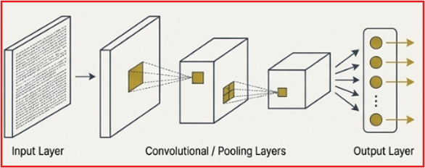
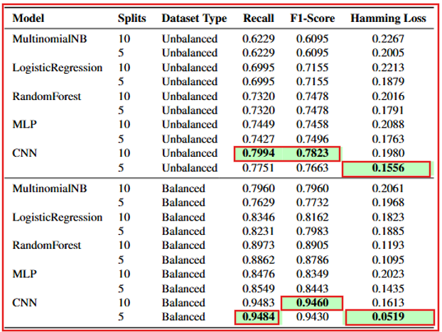
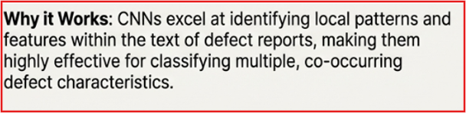
Objective 2 : Impact of Class Balancing in Multilabel Prediction
Tab. 5. CNN outperforms other models with the best F1-Score and lowest Hamming Loss in both balanced and unbalanced Multilabel datasets without feature selection.

Slide 30
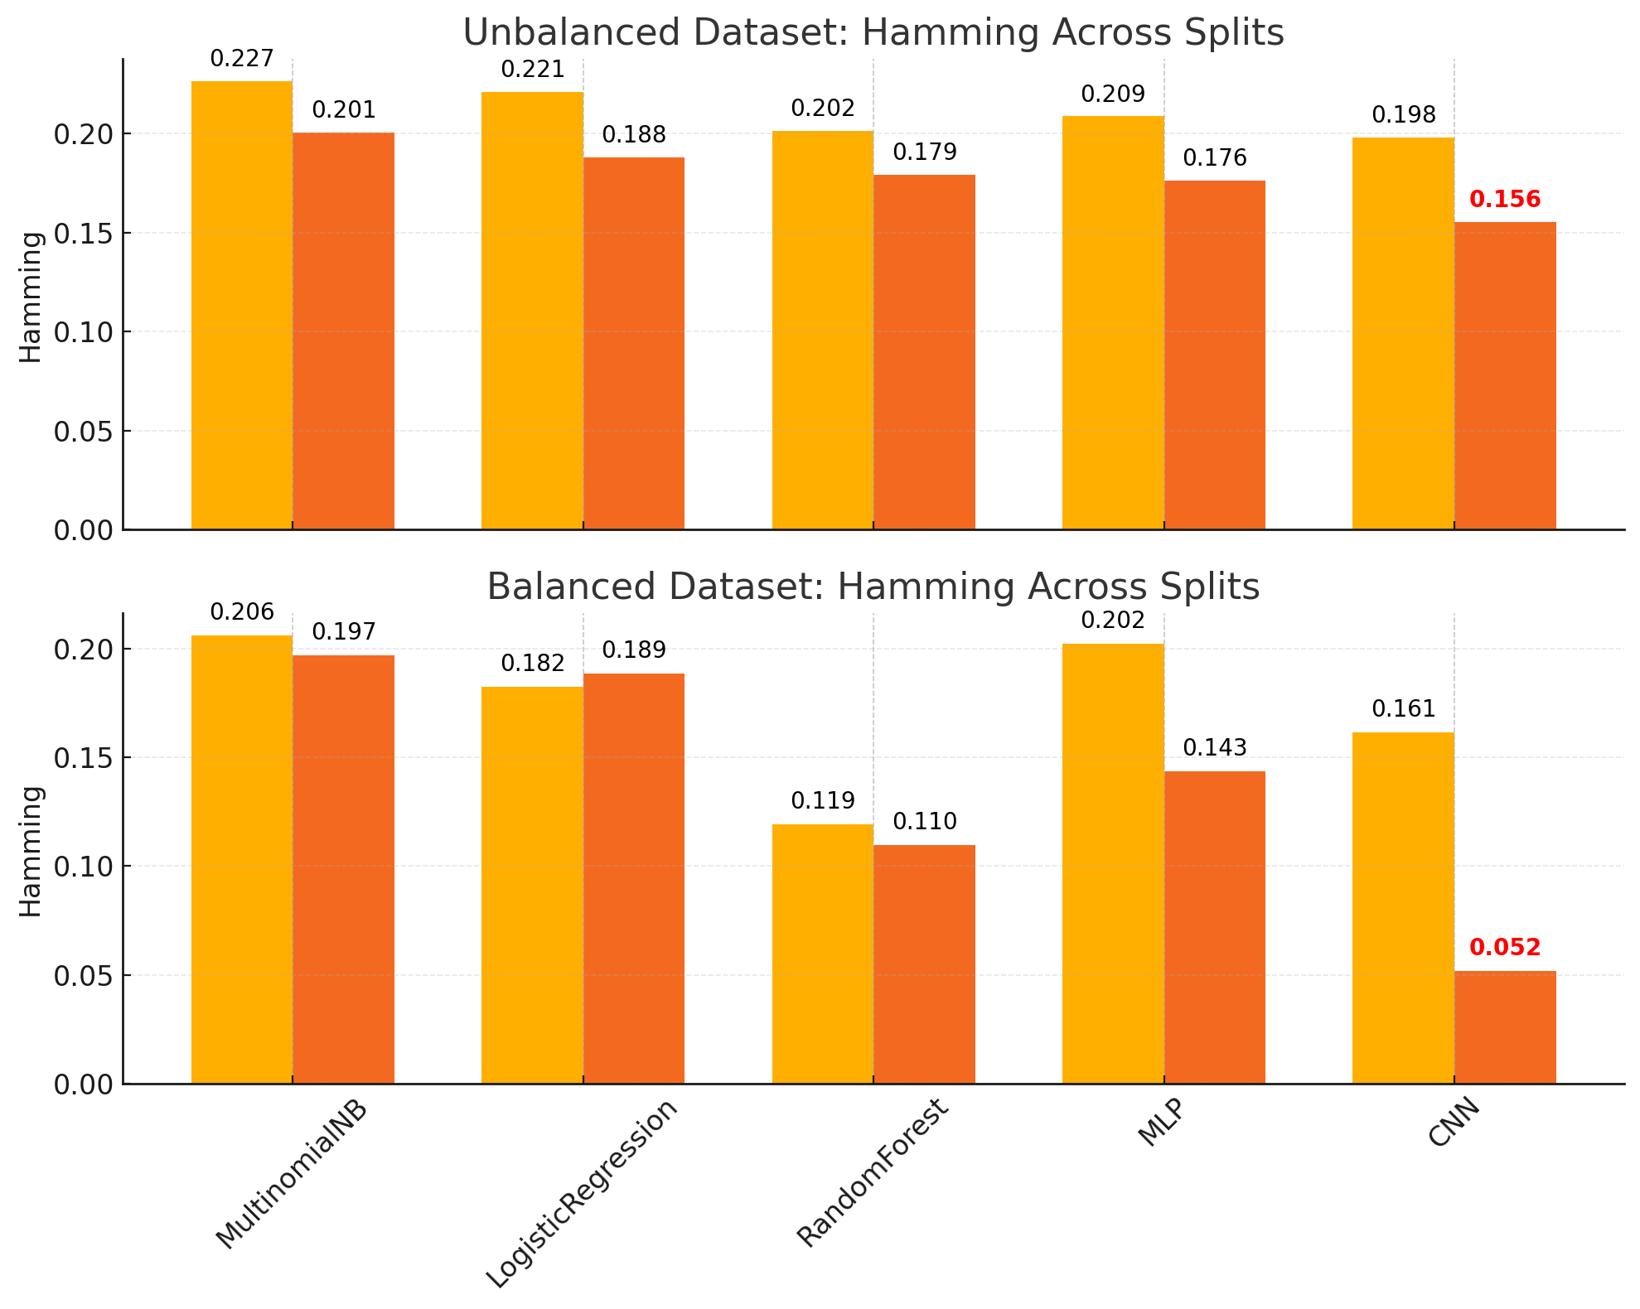
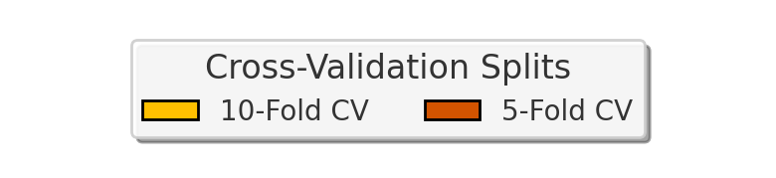
Objective 2 : Hamming Loss for 5 Fold vs 10 Fold for both Unbalanced and Balanced settings ( All Features)
Fig. 17. CNN outperforms –Hamming Loss in both balanced and unbalanced Multilabel datasets without 10 fold and 5 –fold cross validation

Slide 31
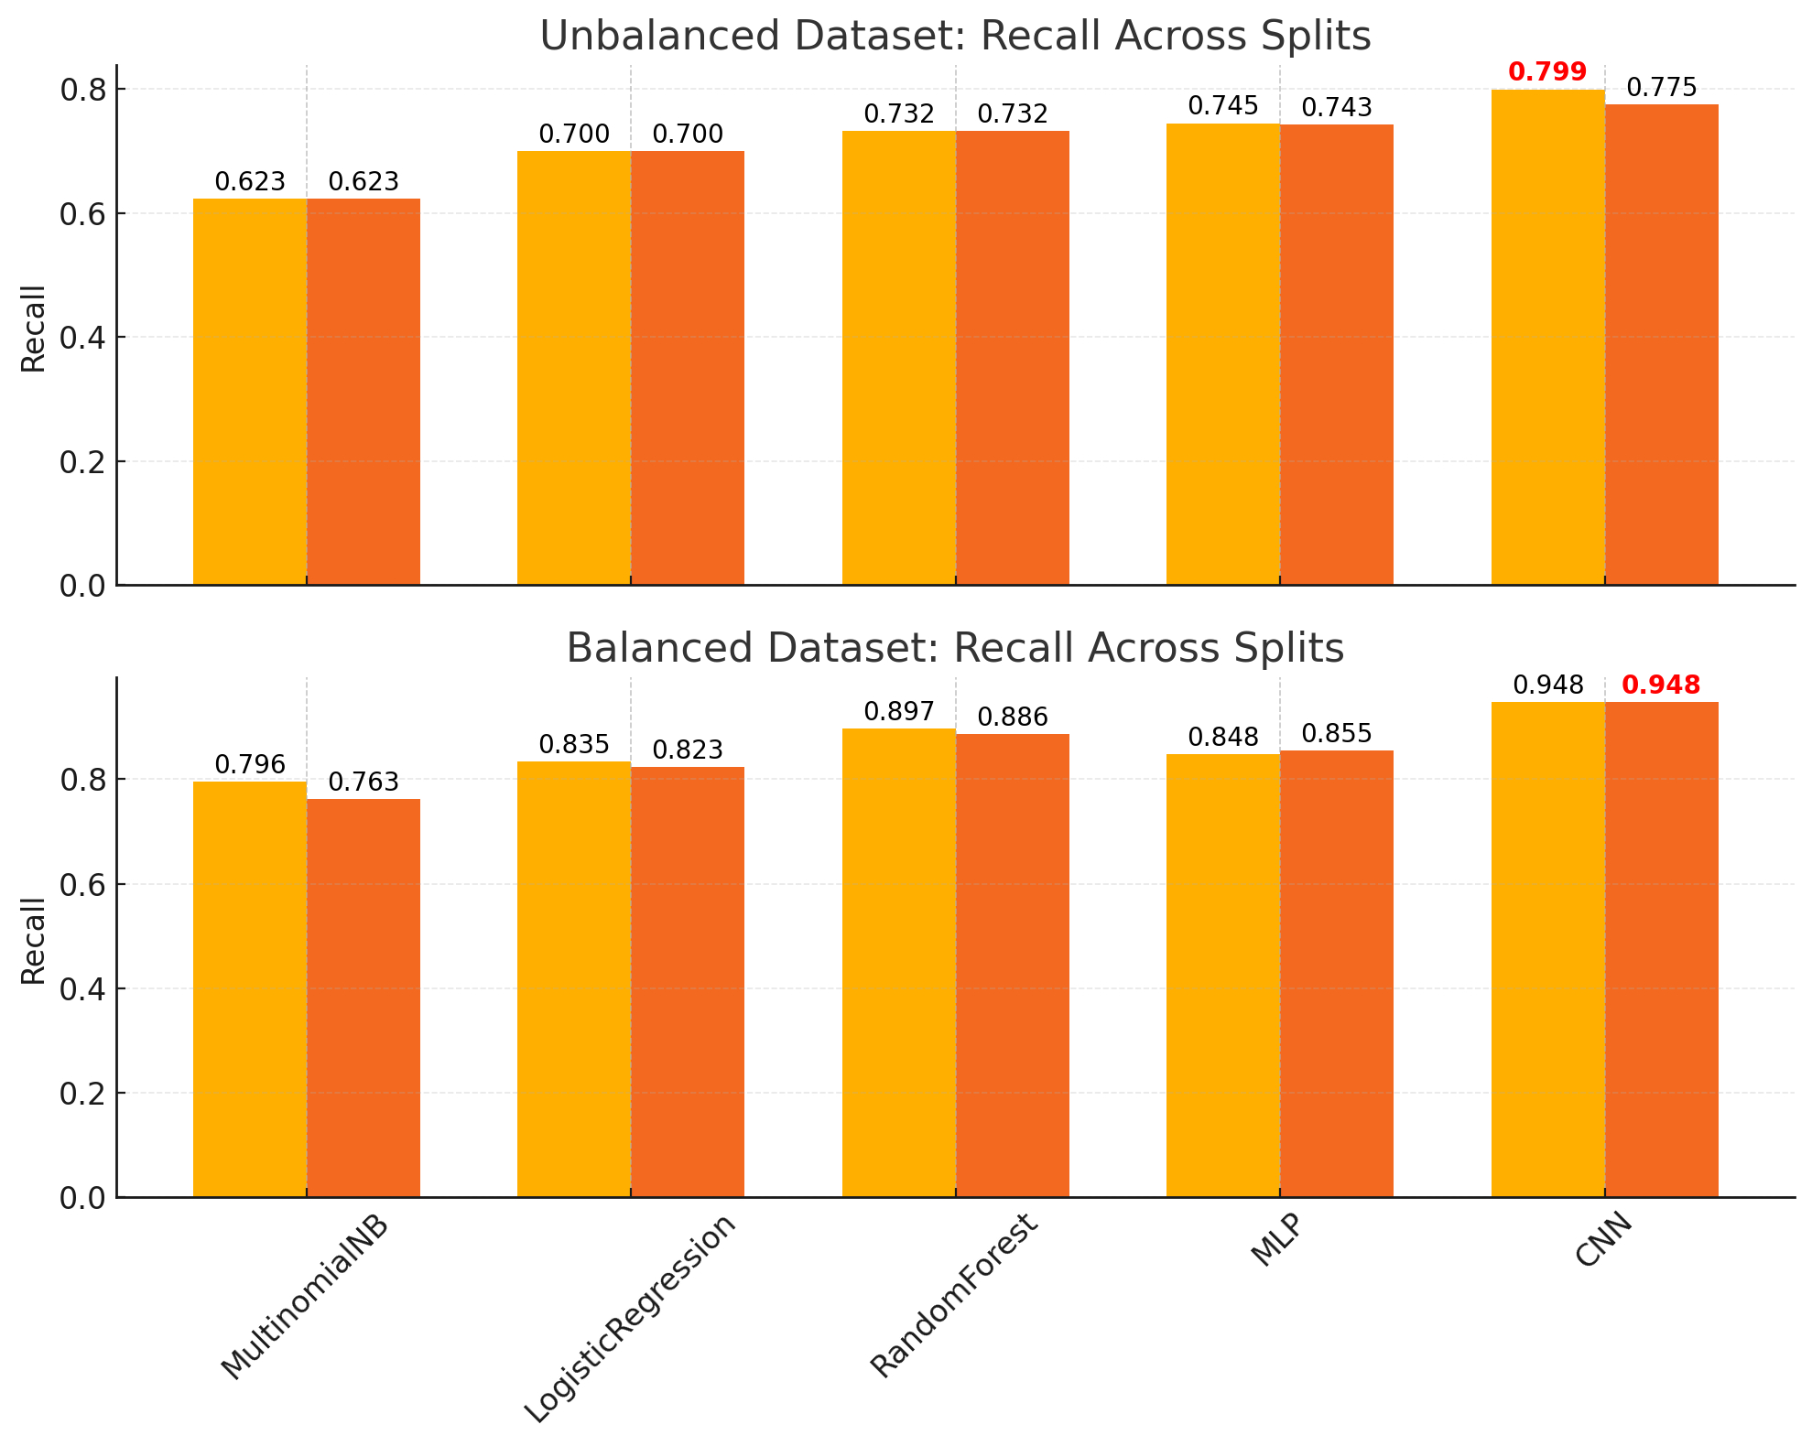
Objective 2 :Recall for 5 Fold vs 10 Fold for both Unbalanced and Balanced settings ( All Features)
Fig. 18. CNN outperforms –Recall in both balanced and unbalanced Multilabel datasets without 10 fold and 5 –fold cross validation

Slide 32
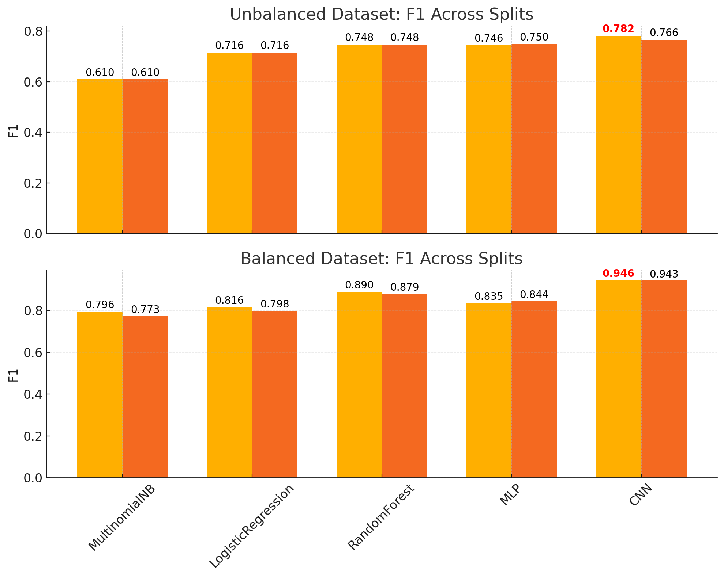
Objective 2 : F1-Score for 5 Fold vs 10 Fold for both Unbalanced and Balanced settings ( All Features)
Fig. 19. CNN outperforms –F1-Score in both balanced and unbalanced Multilabel datasets without 10 fold and 5 –fold cross validation

Slide 33
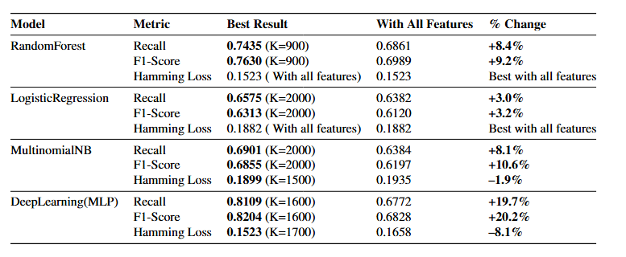
Objective 2 : Impact of Feature selection (Recall, F1-Score, and Hamming Loss ) on balanced dataset
Tab.6. Performance comparison of Multilabel defect classification models with and without feature selection, evaluated on Recall, F1-Score, and Hamming Loss metrics.

Slide 34
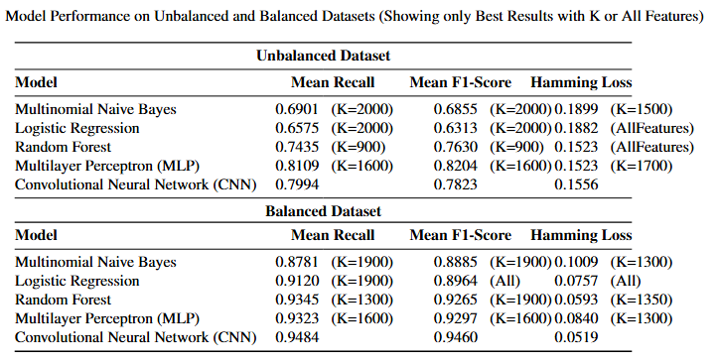
Objective 2 : Impact of class balancing ( Best results with/without feature selection which ever is best)
Tab. 7. Model performance on multilabel defect classification for unbalanced and balanced datasets.

Slide 35
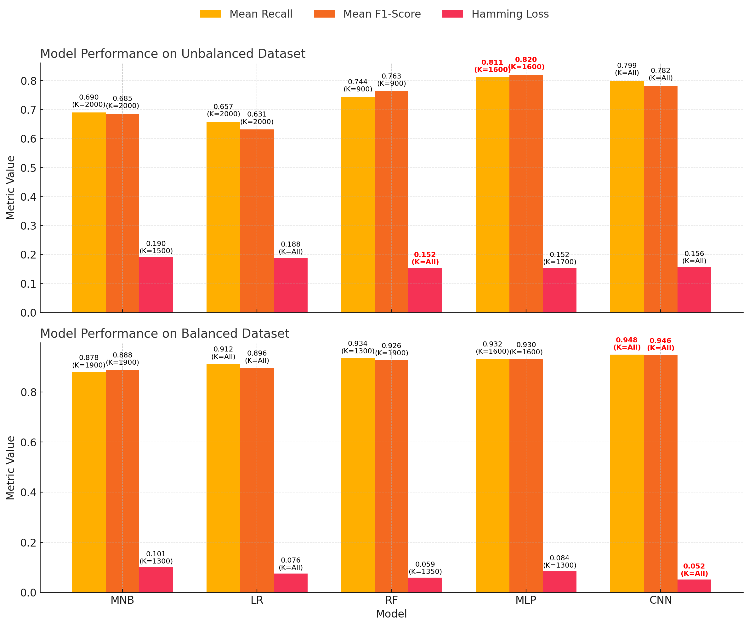
Objective 2 : 10 Fold Cross Validation with Top K features
Fig. 20. CNN outperforms – for both balanced and unbalanced Multilabel datasets with 10 fold cross validation with Top K features

Slide 36
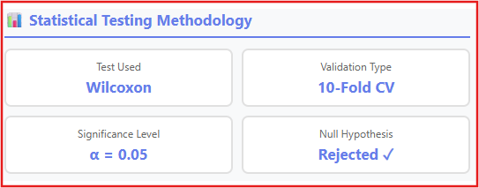
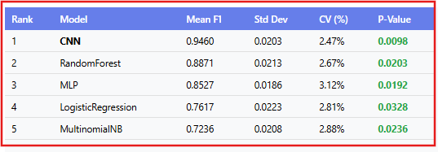
Objective 2 : Statistical Validation of Results (Review Question)
🔬 Wilcoxon Signed-Rank Test
Non-parametric test ideal for paired data without assuming normal distribution. Compares macro-F1 scores from 10-fold cross-validation.
📈 Hypothesis Testing
H₀: No significant performance difference between models- Hₐ: Significant performance improvement exists
🧪 Why Wilcoxon Signed-Rank Test
Tab.8. Performance comparison of Multilabel defect classification models with and without feature selection, evaluated on Recall, F1-Score, and Hamming Loss metrics.

Slide 37
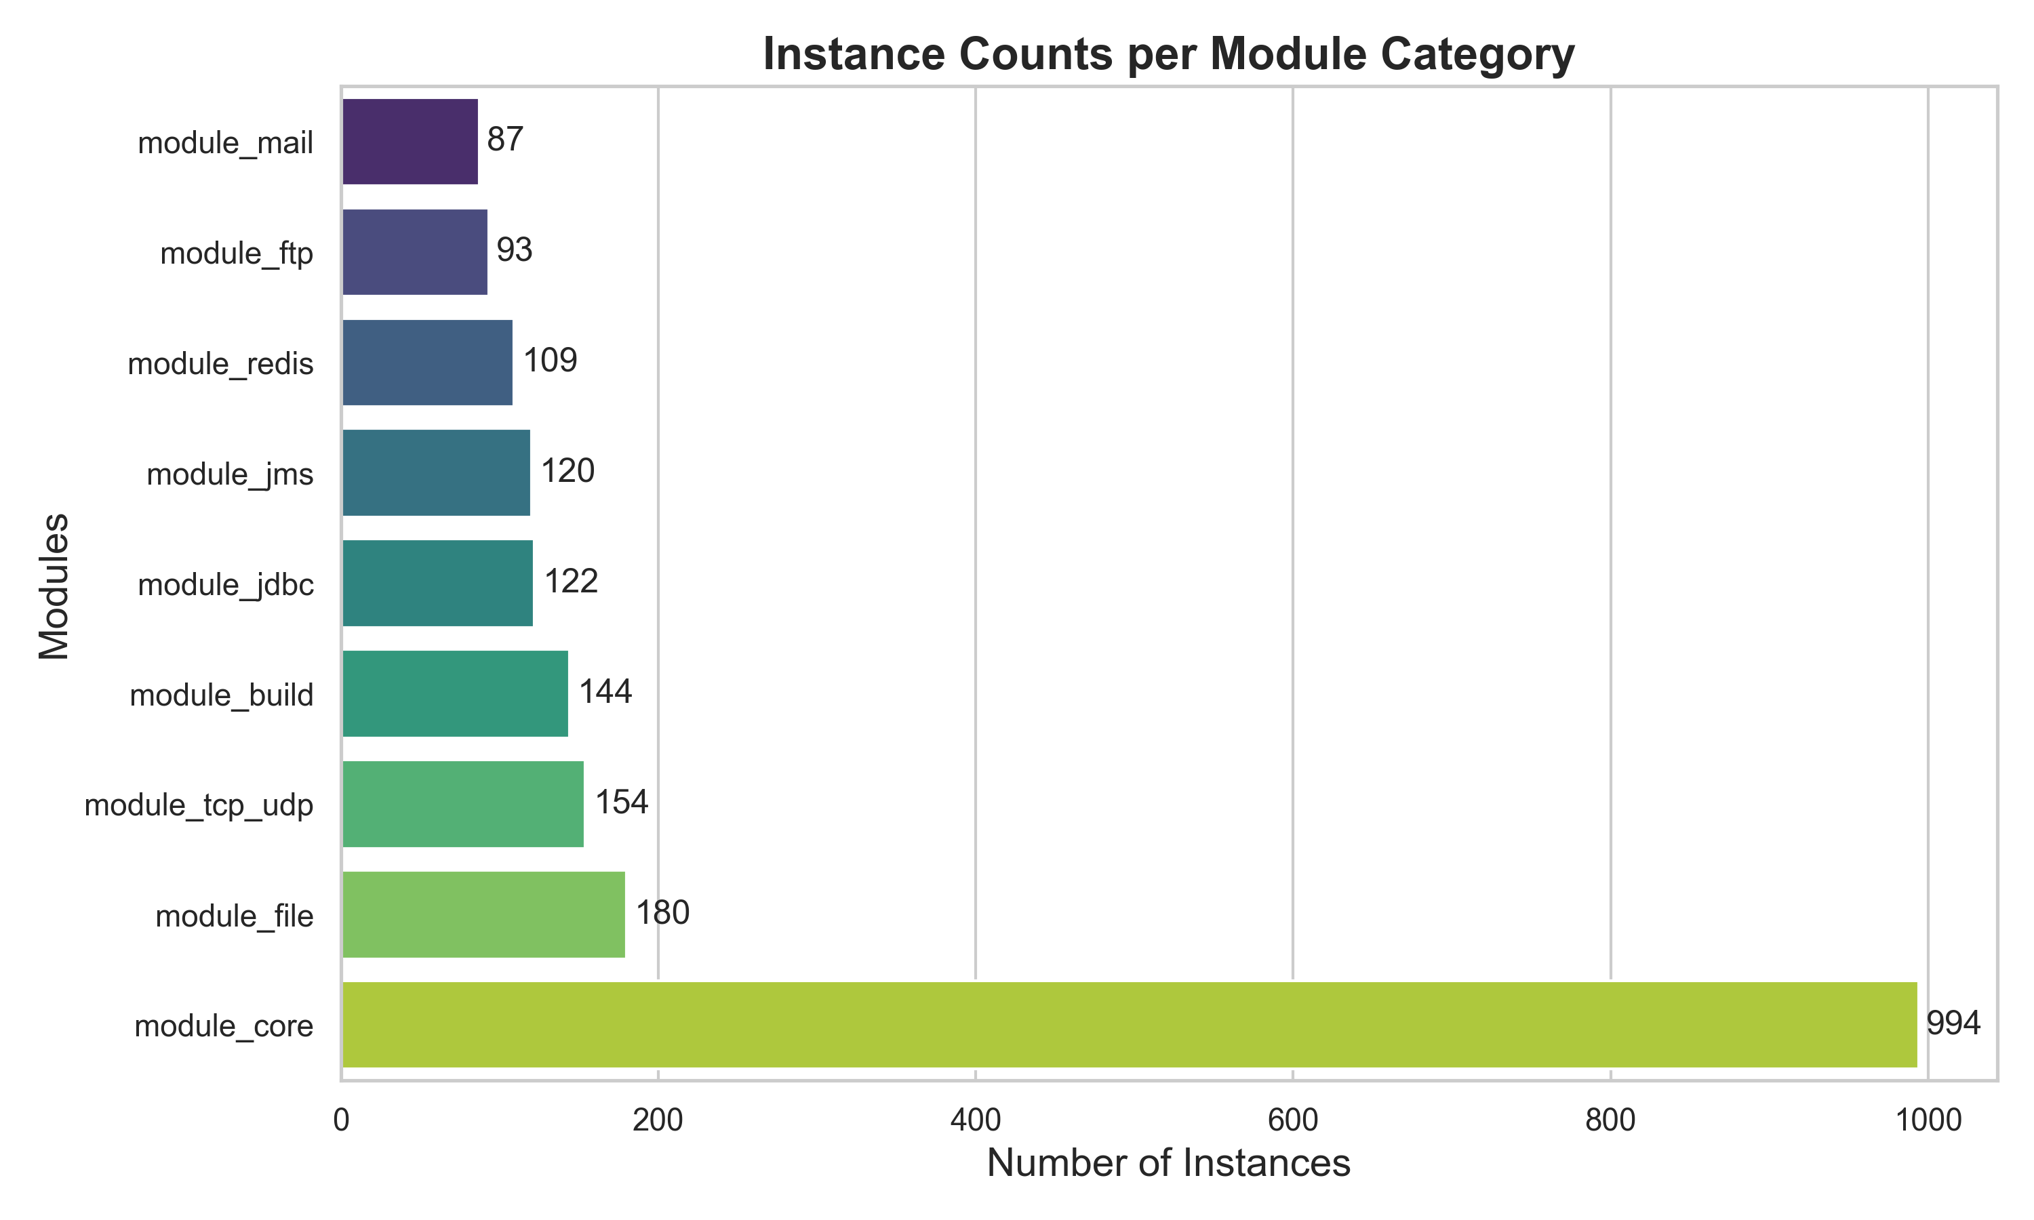
Objective 3 : Multiclass sample distribution for Module prediction
Fig. 21. Module-wise instance distribution highlights a major skew toward module_core, which contains 994 entries, dominating the Multiclass dataset.

Slide 38
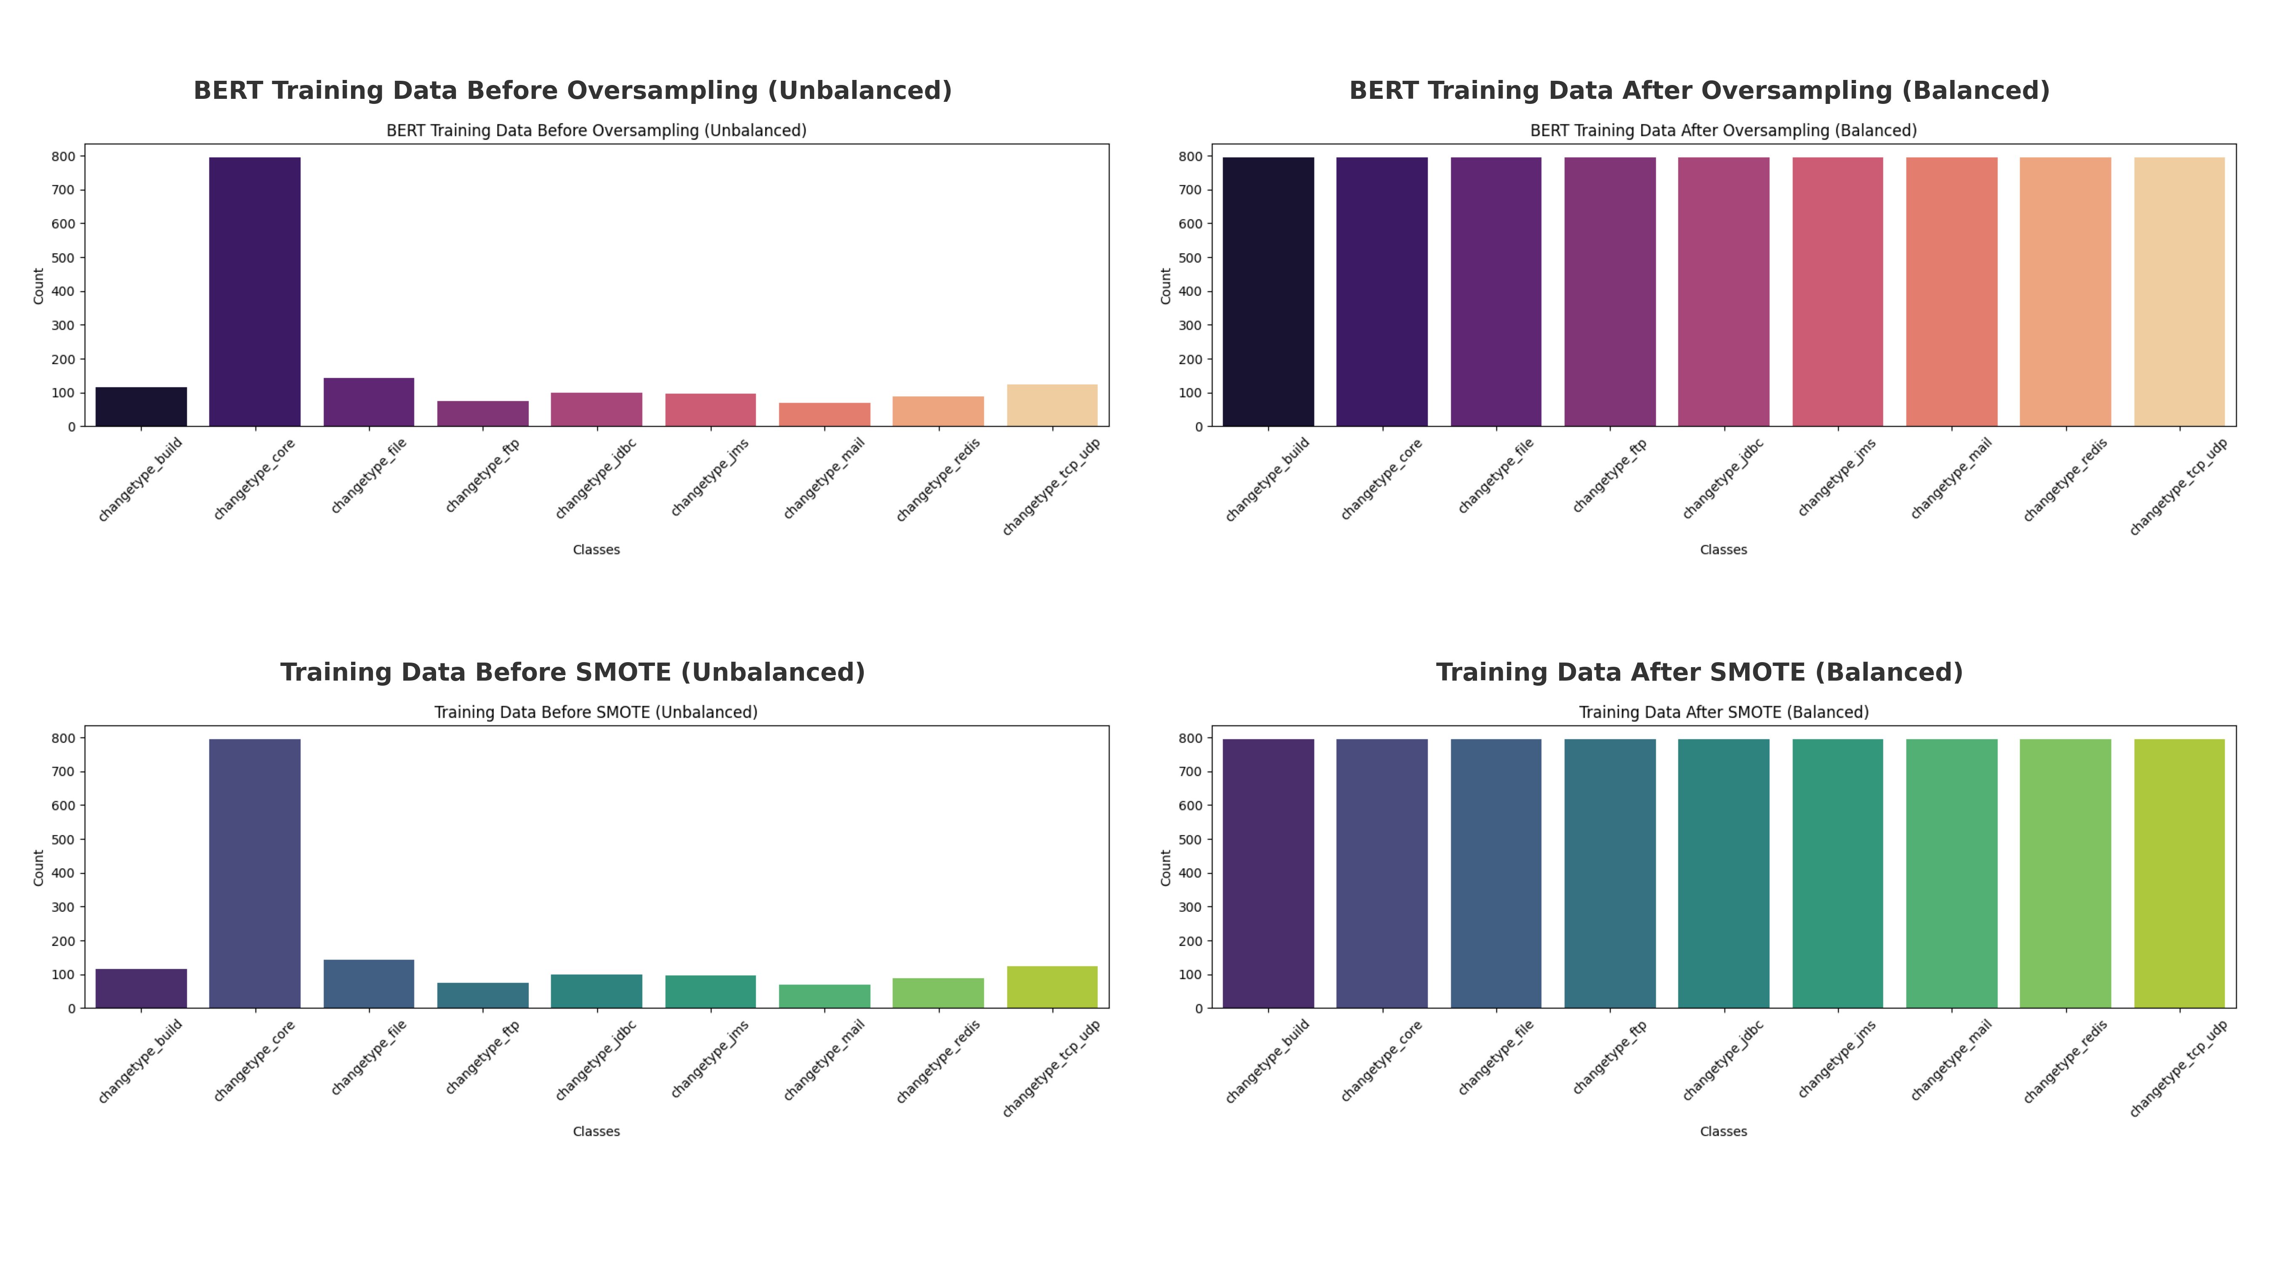
Objective 3 : Before and After Class balancing(SMOTE/Over Sampling)
Fig. 22. Training distribution before and after SMOTE/oversampling shows successful class balance for both traditional and BERT-based multiclass models.

Slide 39



Objective 3 : Multiclass performance on Unbalanced/Balanced Data
Tab. 9. BERT consistently outperforms traditional models across all metrics, with balanced data yielding the highest performance in multiclass classification.

Slide 40



Objective 3 : Contextual understanding why BERT leads (Review Question)
Fig. 23. Reason BERT consistently outperforms

Slide 41

Objective 3 :Visual for Multiclass performance on Unbalanced Data
Fig. 24. On unbalanced data, BERT consistently outperforms other multiclass models across all evaluation metrics.

Slide 42

Objective 3 :Visual for Multiclass performance on Balanced Data
Fig. 25. Evaluation of multiclass classifiers on balanced data reveals BERT achieving highest scores across all metrics.

Slide 43

Objective 3 :Combined Visuals for Multiclass performance on Unbalanced and Balanced Data
Fig. 26. BERT achieves highest scores across all metrics, and all models show improved performance after balancing.

Slide 44

Objective 3 : Comparing Nature based Optimizers vs Base ML models for multiclass module prediction ( Unbalanced)
Tab. 10. Multiclass classifier performance using nature-inspired algorithms; GWO and PSO consistently improve over base models for un-balanced dataset

Slide 45

Objective 3 : Visuals for Comparing Nature based Optimizers vs Base ML models for multiclass module prediction ( Unbalanced)
Fig. 27. Performance of multiclass models on unbalanced data using base vs. nature-inspired algorithms (GA, GWO, PSO) across accuracy, precision, recall, and F1-score.

Slide 46

Objective 3 :Comparing Nature based Optimizers vs Base ML models for multiclass module prediction ( Balanced)
Tab. 11. Performance of multiclass classifiers with nature-inspired algorithms; PSO yields best results across most metrics for balanced dataset.

Slide 47

Objective 3 : Comparative Analysis of Nature-Inspired Optimizers and Base ML Models (Balanced Multiclass Prediction)
Fig. 28. Comparative performance of multiclass models on balanced data using base and nature-inspired algorithms (GA, GWO, PSO) across four evaluation metrics.

Slide 48
Objective 3: TF-IDF vs SBERT — ML Model Performance in Balanced & Unbalanced Multiclass Data
Unbalanced (SBERT used for Vectorization for ML Models)
Model | Accuracy | Precision | Recall | F1‑Score
Logistic Regression | 0.81 | 0.81 | 0.81 | 0.80
Linear SVM | 0.86 | 0.86 | 0.86 | 0.86
Gaussian NB | 0.83 | 0.85 | 0.83 | 0.83
Random Forest | 0.66 | 0.73 | 0.66 | 0.60
BERT (Unbalanced) | 0.85 | 0.86 | 0.85 | 0.85
Balanced (SBERT used for Vectorization for ML Models)
Model | Accuracy | Precision | Recall | F1‑Score
Logistic Regression | 0.85 | 0.86 | 0.85 | 0.85
Linear SVM | 0.83 | 0.84 | 0.83 | 0.83
Gaussian NB | 0.81 | 0.82 | 0.81 | 0.81
Random Forest | 0.83 | 0.84 | 0.83 | 0.82
BERT (Balanced) | 0.89 | 0.89 | 0.89 | 0.88
Tab. 12. Unbalanced and Balanced Training Results (SBERT vs. BERT)

Slide 49

Objective 3: Visual Comparison of TF-IDF vs SBERT for ML Models in Multiclass (Balanced Setting)
Fig. 29. Balanced Training Results (SBERT vs. BERT)

Slide 50

Objective 3 :Visuals for Comparing TF-IDF/SBERT for ML models in Multiclass , Unbalanced Settings
Fig. 30. UnBalanced Training Results (SBERT vs. BERT)

Slide 51

Objective 4 : Automation Tool : SDPTool User Interaction ( Review Question)
Fig. 31. SDPTool GUI based tool - Workflow

Slide 52


Objective 4 : End to End Automation Tool for Multilabel and Multiclass Predictions - Configuration
Fig. 32. SDPTool GUI developed using Java Swing with a SQLite–Python backend, enables configuration, GitHub access, and export of defect datasets to CSV.

Slide 53

Objective 4 : End to End Automation Tool for Multilabel and Multiclass Predictions - Preprocessing
Fig. 33. The preprocessing module initiates stop-word removal, normalization, and data validation steps, with progress visually tracked via a status bar.

Slide 54

Objective 4 : End to End Automation Tool for Multilabel and Multiclass Predictions – Feature Engineering
Fig. 34. The Feature Engineering module, Top K Features

Slide 55

Objective 4 : End to End Automation Tool for Multilabel and Multiclass Predictions – AI Model selection
Fig. 35. The AI Model selection module

Slide 56

Objective 4 : End to End Automation Tool for Multilabel and Multiclass Predictions – Results Visualization Control
Fig. 36. The Visualization module for graph, chart selections

Slide 57

Objective 4 :End to End Automation Tool for Multilabel and Multiclass Predictions – Report generated by Tool
Fig. 37. The Multilabel Report sample generated by Tool

Slide 58


Objective 4 : Integrating Tool to GitHub CI/CD Pipeline ( Review Question)
Fig. 38. Integration mechanism of SDPTool with CI/CD GitHub pipeline

Slide 59

Conclusion
Tab. 14. Conclusion - Multilabel & Multiclass Classification

Slide 60



Contributions ( Review Question)
.

Slide 61

Future Scope

Slide 62





Slide 63

Scope and Limitations

Slide 64

Research Publication

Slide 65

Research Publication

Slide 66

Research Publication

Slide 67

Research Publication

Slide 68
References
[1] S. Lessmann, B. Baesens, C. Mues, and S. Pietsch, “Benchmarking classification models for software defect prediction: A proposed framework and novel findings,” IEEE Trans. Softw. Eng., vol. 34, no. 4, pp. 485–496, Jul.–Aug. 2008, doi: 10.1109/TSE.2008.35.
[2] T. M. Khoshgoftaar and E. B. Allen, “Logistic regression modeling of software quality,” Int. J. Reliab. Qual. Saf. Eng., vol. 8, no. 6, pp. 365–376, Dec. 2001, doi: 10.1142/S0218539301000456.
[3] C. Catal and B. Diri, “Investigating the effect of dataset size, metrics sets, and feature selection techniques on software fault prediction problem,” Inf. Sci., vol. 179, no. 8, pp. 1040–1058, Apr. 2009, doi: 10.1016/j.ins.2008.11.028.
[4] L. Pascarella, V. Lenarduzzi, and M. Di Penta, “When and how using machine learning classifiers in bug prediction: A replicated study,” Empir. Softw. Eng., vol. 25, no. 6, pp. 4579–4625, Nov. 2020, doi: 10.1007/s10664-020-09840-6.
[5] Y. Jiang, B. Cukic, and T. Menzies, “Can data transformation help in the detection of fault-prone modules?,” Proceedings of the IEEE International Workshop on Program Comprehension (IWPC), pp. 10–19, Jun. 2008, doi: 10.1109/WPC.2008.14.

Slide 69
References
[6] B. Ghotra, S. McIntosh, and A. E. Hassan, “Revisiting the impact of classification techniques on the performance of defect prediction models,” Proceedings of the 37th International Conference on Software Engineering (ICSE), pp. 789–800, May 2015, doi: 10.1109/ICSE.2015.90.
[7] M. Qiu, F. Liu, Y. Qian, and M. Guo, “A cross-project software vulnerability prediction approach based on deep learning,” IEEE Access, vol. 7, pp. 170827–170838, Nov. 2019, doi: 10.1109/ACCESS.2019.2955474.
[8] Q. Liang, Z. Yang, Z. Xu, Z. Li, and K. Chen, “Deep learning-based software defect prediction with improved class imbalance strategy,” IEEE Access, vol. 7, pp. 115995–116006, Aug. 2019, doi: 10.1109/ACCESS.2019.2935306.
[9] Y. Fan, W. Xu, X. Liu, and Y. Ma, “An attention-based recurrent neural network model for software defect prediction,” IEEE Access, vol. 7, pp. 91220–91230, Jul. 2019, doi: 10.1109/ACCESS.2019.2926480.
[10] K. Gao and H. Wang, “A novel method for software defect prediction using MLP with SMOTE,” J. Softw., vol. 9, no. 1, pp. 93–100, Jan. 2014, doi: 10.4304/jsw.9.1.93-100.

Slide 70
References
[11] Y. Dong, Z. Wu, and H. Yang, “Android defect prediction using deep learning,” IEEE Access, vol. 6, pp. 11822–11829, Mar. 2018, doi: 10.1109/ACCESS.2018.2799520.
[12] H. D. Phan, T. T. Nguyen, D. Phung, and S. M. Nguyen, “Convolutional neural networks over control flow graphs for software defect prediction,” Proceedings of the 26th International Joint Conference on Artificial Intelligence (IJCAI), pp. 1236–1242, Jul. 2018, doi: 10.24963/ijcai.2018/171.
[13] H. Lu, J. Jiang, and Z. Zhang, “A survey of learning-based intelligent software defect prediction,” Cluster Comput., vol. 18, no. 2, pp. 795–811, Jun. 2015, doi: 10.1007/s10586-014-0405-2.
[14] T. Hall, S. Beecham, D. Bowes, D. Gray, and S. Counsell, “A systematic literature review on fault prediction performance in software engineering,” IEEE Trans. Softw. Eng., vol. 38, no. 6, pp. 1276–1304, Nov.–Dec. 2012, doi: 10.1109/TSE.2011.103.
[15] H. Hämäläinen, A. Das, and T. Mikkonen, “A systematic literature review of multilabel learning in software engineering,” Journal of Systems and Software, vol. 209, 111727, Feb. 2024, doi: 10.1016/j.jss.2023.111727.

Slide 71
References
[16] Y. Ma, G. Luo, X. Zeng, and A. Chen, “Transfer learning for cross-company software defect prediction,” Information and Software Technology, vol. 54, no. 3, pp. 248–256, Mar. 2012, doi: 10.1016/j.infsof.2011.09.007.
[17] Y. Li, S. Wang, and Q. Gu, “Hyperparameter tuning in software defect prediction with transfer learning,” Empirical Software Engineering, vol. 25, no. 5, pp. 3930–3967, Sep. 2020, doi: 10.1007/s10664-020-09821-9.
[18] Y. Xu, Z. Chen, J. Zhu, and D. Zhang, “Software defect prediction based on deep learning with autoencoders,” Information and Software Technology, vol. 106, pp. 20–36, Mar. 2019, doi: 10.1016/j.infsof.2018.09.002.
[19] Consortium for IT Software Quality (CISQ), The Cost of Poor Quality Software in the US, 2022. [Online]. Available: https://www.it-cisq.org/wp-content/uploads/sites/6/2022/11/CPSQ-Report-Nov-22-2.pdf
[20] Zhang, Ximing, et al. "Enhancing label correlation feedback in multi-label text classification via multi-task learning." arXiv preprint arXiv:2106.03103 (2021).
[21] SDP Tool Demo link - https://github.com/jalajpachouly/SDPTool/blob/main/video-demo.zip

Slide 72

Notes:
maaa

